Slide 1


Slide 2

Unicode 8 for Tcl
Jan Nijtmans
june 20, 2015

Slide 3
Summary
History of Unicode
Tcl TIP’s
Tcl “string” functions
SQLite (FTS3: full text search)
fossil
Conclusion
Questions?
Notes:
1953 Oprichting
1966 Start Wim van der Leegte
1972 Overname aandelen
1977 Start open overlegstructuur
1979 Start groei

Slide 4
History
8.0 (june 17, 2015)
7.0 (june 16, 2014)
6.3.0 (sept 30, 2013)
6.0.0 (okt 11, 2010)
5.2.0 (okt 1, 2009)
4.0.0 (april, 2003)
3.0.0 (feb 29, 2000)
2.0.0 (july, 1996)
1.0.0 (okt, 1991)

Slide 5
Unicode 8.0
Lowercase Cherokee syllables (uppercase since Unicode 3.0)
Emoij characters
Stability Policy Update
  The case folding stability policy has been clarified to account for the fact that the case folding target may be either lowercase or uppercase.

Slide 6
Unicode 6.x
Unicode 6.1: used by upstream SQLite (FTS3)
Unicode 6.3: mongolian vowel separator no longer considered as being a space. Inspiration for TIP #413

Slide 7
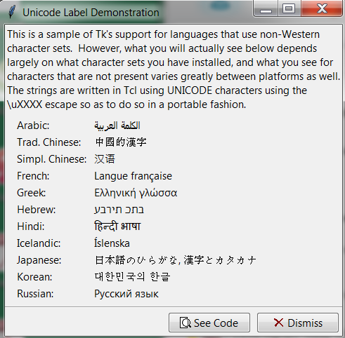
Unicode 3.0
Used by Tcl 8.1 (1999)
  except > U+FFFF
  tools/uniParse.tcl
  tools/uniClass.tcl

Slide 8
Tcl TIP’s
#318: Extend Default Whitespace in ‘string trim’ beyond ASCII (done but obsoleted by #413
#413: Unicode support for ‘string is space’ and ‘string trim’ (Tcl 8.6: done)
#388: Extending Unicode literals past the BMP (Tcl 8.6: done)
#389: Full support for Unicode 6.0.
  Behavior change of Tcl_UtfToUniChar()/Tcl_UniCharToUtf()
main/wmain
#425: Internationalization of Default Panic Callback on Windows

Slide 9
Tcl ‘string trim’ and ‘string is space’
TIP #413: consistancy between those two commands
  Any character for which ‘string is space’ returns 1, will be trimmed by ‘string trim’
  All Unicode characters having “White_Space” property
  U+FEFF: zero width no-break space (BOM)
  U+2060: word joiner
  U+200B: zero width space (Unicode 3.0)
  U+180E: mongolian vowel separator (became space in Unicode 4.0, dropped in Unicode 6.3)

Slide 10
Tcl string functions
string tolower / string toupper
string is alnum/alpha/control/digit/graph/lower/
print/punct/space/upper/wordchar/xdigit
regexp [:alnum:] [:alpha:] [:blank:] [:control:] …
string casefold ???

Slide 11
SQLite/Fossil
SQLite FTS3: Uses Unicode 6.1 for tokenization
  ext/fts3/unicode/mkunicode.tcl
Fossil uses Unicode for regular expressions
  copy tables from SQLite, upgraded to 8.0 now
TEA version of SQLite 3.8.11: tables upgraded to 8.0

Slide 12
Conclusion
Unicode: more stability in later versions
Tcl >8.1: follows closely the Unicode standard, except for characters > U+FFFF
Tcl 8.7: Hopefully TIP #389 accepted

Slide 13
Questions?

